Slide 1
January 22, 2013 Literacy L & L
Strategies Covered 1st Semester Review (Bell Work) : Please use NB paper at your tables to try to recall as many of the 5 key strategies we practiced, individually or collaboratively.
December Table Share & Next Steps
Survey Results & Implications for 2nd semester meetings
Today’s Strategy: Reading Images (Visuals)

Slide 2
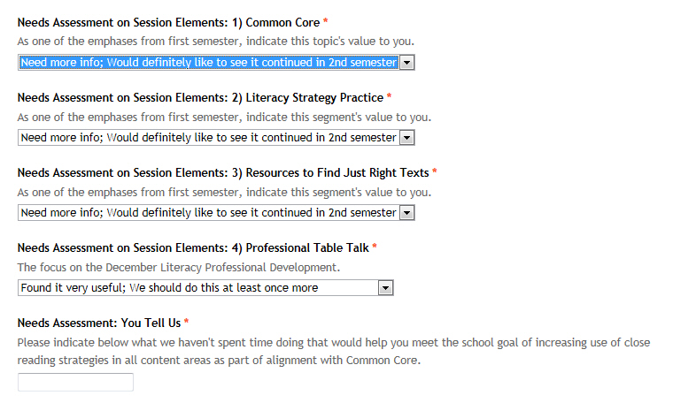

Slide 3
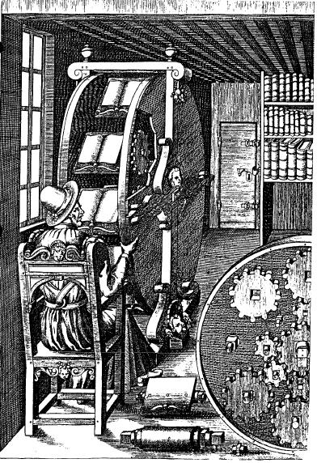

Slide 5
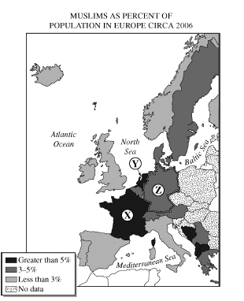

Slide 6
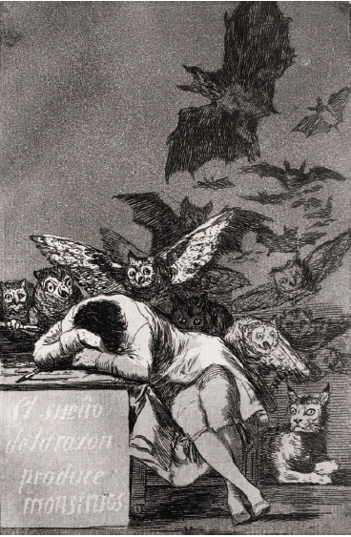

Slide 7
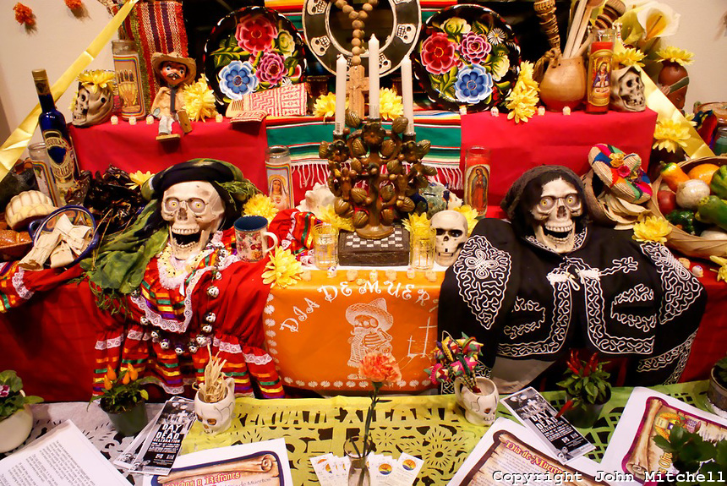

Slide 8
